Slide 1


Twitter Plaintext Logging
A Case Study on Internal Defects & The Fragility of Password Masking
Topic Cybersecurity / Data Privacy
Case Year 2018
Impact 330M+ Users

Slide 2

1. Introduction: What Happened?
The Discovery
On May 3, 2018, Twitter disclosed that a bug had caused user passwords to be stored unmasked in an internal log file.
While Twitter uses industry-standard bcrypt hashing to mask passwords, this defect recorded the raw plaintext data before the masking process was finalized.
The company urged its entire user base—330 million people—to change their passwords as a precaution.

Slide 3






2. Architecture & Data Flow
Bcrypt Process
The Failure Point
Intended Masking
User enters password → Bcrypt algorithm salts & hashes → Resulting hash stored in DB. Secure by design.
Before Bcrypt completed, the internal logging system captured the input buffer. Plaintext was written to disk.
Passwords are never meant to be readable by any employee. The bug bypassed this critical trust boundary.

Slide 4

3. Technical Analysis: The Bug
Why it failed?
Twitter's hashing function replaces the password with a random set of characters. This allows validation without storage.
The bug existed in the logging layer. During a traffic surge or system update, passwords were inadvertently dumped into a internal debug log.
Formula used for validation:

Slide 5
4. Threat Model: STRIDE Analysis
Category | Internal Bug Finding | Impact
Spoofing | Malicious internal actor impersonating log analyst. | Account Takeover
Tampering | Logs could be altered to hide data extraction. | Audit Trail Loss
Info Disclosure | Plaintext passwords exposed in local logs. | Massive Privacy Breach
Denial of Service | Large log files filling up internal disk space. | System Instability
Elevation | Access to logs provides keys to highly privileged accounts. | Total Hijack

Slide 6
5. Scale of the Issue
The Precautionary Call
330M
While Twitter stated there was no evidence of an external breach or misuse, the sheer volume of passwords potentially exposed meant a platform-wide warning was necessary.
This incident is one of the largest "potential" exposures in history, highlighting that internal hygiene is as important as external perimeter defense.
Users Affected

Slide 7
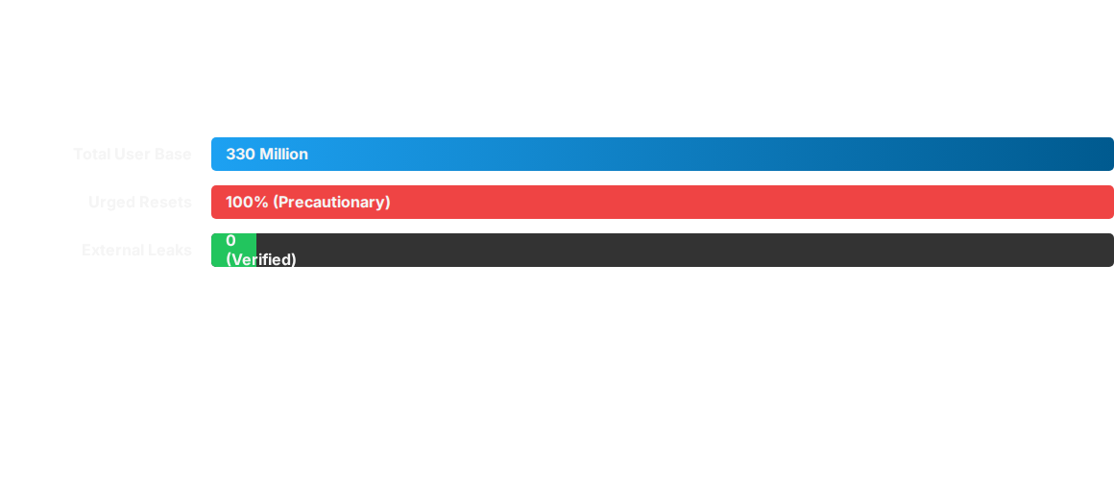
6. Comparative Impact
Data highlights the contrast between the *potential* risk and the *actual* observed misuse.

Slide 8



7. Remediation: Timeline
Discovery
Fixing
Purging
Disclosure
Bug found during internal engineering review.
Logging defect patched and code reviewed.
Internal log files containing plaintext were wiped.
Public announcement and reset recommendation.

Slide 9
8. Leadership Accountability
“
"We found this error ourselves, removed the passwords, and are implementing plans to prevent this bug from happening again. We’re very sorry this happened."
— Jack Dorsey, CEO of Twitter (2018)

Slide 10
9. Lessons: Internal Security
Audit Your Logs: Logging systems are often overlooked. They must be audited with the same rigor as production databases to ensure sensitive data (PII) is not captured.
Hashing is Not Enough: If your system logs the "input" buffer before hashing, the strength of the algorithm (bcrypt) becomes irrelevant.
Least Privilege Access: Internal logs should have restricted access. If a bug occurs, only a few highly vetted engineers should be able to view the data before it is purged.
Transparency Matters: Twitter’s proactive disclosure saved their reputation despite the scale of the error. Honesty prevents fallout.

Slide 11

Questions?
Twitter Password Security Incident Case Study
Reference: Twitter Engineering Blog, May 2018

Slide 12



Image Sources
https://img.freepik.com/premium-vector/social-media-icon-twitter_1043920-190.jpg?semt=ais_hybrid&w=740&q=80
Source: www.freepik.com
https://static.vecteezy.com/system/resources/thumbnails/075/948/456/large/binary-code-0-and-1-abstract-digital-data-flow-animation-footage-blue-text-on-black-background-video.jpg
Source: www.vecteezy.com
https://live.mgm-tp.com/wp-content/uploads/2019/04/Fig5-Incremental-conversion-process.png
Source: insights.mgm-tp.com

